Slide 1
CIS150 - Fundamentals of
Information Systems
University of Louisville
Spring Semester 2010

Slide 2
Presentation Topics
Introduction
My Background
Working with People
Hot Tech Stuff in 2009
Top I.T. Initiatives for 2009
Looking Ahead at 2010

Slide 3
Introduction
Steve Kendra
Professor and “Executive in Residence”
Taught CIS100, CIS150, CIS199, CIS300
Education: BS (Notre Dame) and an MBA
Over 30 Years of Diverse I.T. Experience
Married with Three “Mostly Grown” Sons
Email: sjkend01@louisville.edu

Slide 4
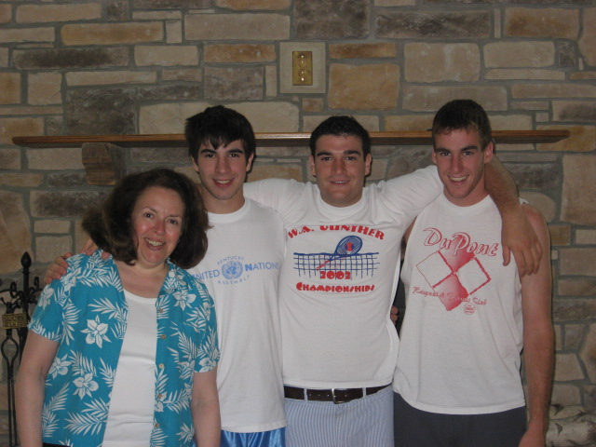
Kendra Family

Slide 5

Big B@ss

Slide 6

My Turn!

Slide 7

Striper!
University of Louisville Spring Semester 2010
Notes:
7

Slide 8

My Background
Diverse I.T. Work Experience
  Applications Development
  Software Engineering / Quality Assurance
  Technology Support
  Project Leadership
  People Management
  Strategic Planning

Slide 9
My Background
Work Experience (con’t)
  Fortune 500 – Amoco, General Dynamics
  Consultant – Point of Sale Systems
  United Parcel Service (UPS)
    Software Engineering & Quality Assurance
    Systems Manager – Applications
    Technology Support Group Manager

Slide 10
My Background
What Did I Do at UPS?
  Led an Organization of 250+ I.T. people
  Provided Technology Support Services
  Managed Annual Budget of Over $10 MM
  Coached, Mentored, Resolved Issues
  Project Planning and Management
  Addressed Internal Customer Expectations

Slide 11
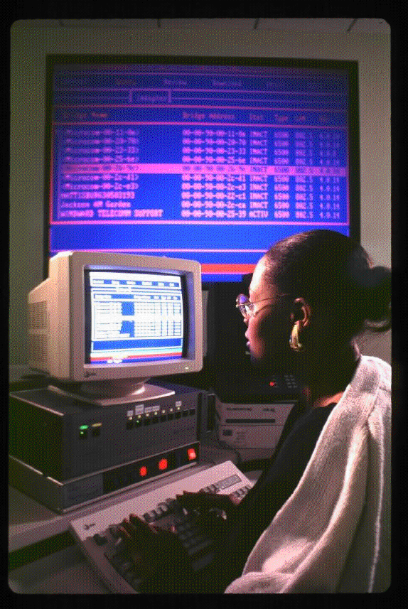
My Background
Technology Services Provided
Hardware and Software Installs
Service Desk Support
Problem Resolution
Asset Management
Network Monitoring
Computer Operations
Systems Security
Project Planning

Slide 12
Working with People
Personal Perspectives
Guiding Principles:
    Do the Right Thing
    Do the Very Best You Can
    Treat Others as You Want to be Treated
Work Hard…
Play Harder…
Make it Fun!

Slide 13





Hot Tech Stuff in 2009
I.T. Budgets Were Tight Again, but…
Cloud Computing
Virtualization
Notebook / Netbook Adoption
Open Source Software
Online Social Networking

Slide 14
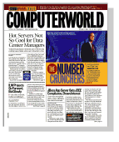
Top I.T. Initiatives in 2009
From the Premier 100 Leaders
Projects that Improve, Transform and Innovate
Reduce Usage and Energy Costs in Data Centers
Server Virtualization and Tiered-Storage
Environmental Adaptation for Cooling and Heating
Virtual Call Center Technology for Telecommuting
Increased Web Access to Government Resources
Strict Focus on Optimizing Value to Business

Slide 15
Looking Ahead at 2010
Much Work in 2009 Sets the Stage
Oracle Assimilates Sun Microsystems
Microsoft Office 10 to be Released in June
Azure Moves into Service for Cloud Computing
Bing Search and Maps will gain Market Share
Windows 7 to be Deployed by Many Corporations
New Devices will Ship with Google’s Chrome OS
HTML 5 will Emerge as a Standard for Web Apps

Slide 16
Questions

